Slide 1

Smart Surveillance System with Real Time Threat Detection Using AWS
Presented By -
Vathslaya.Kagithala

Slide 2
Abstract
 Introduction
 Literature Review
 Software and Hardware Requirements
 Existed system and Proposed system
 Objective and scope of the project
 Architecture of the project
 Algorithms used and how it is working
 Sample outputs and graphs
 Conclusion
 Future scope
 References
AGENDA

Slide 3
ABSTRACT
Smart Surveillance System with Real Time Threat Detection Using AWS using YOLOv5 for webcam and YOLOv8 for uploaded video analysis, integrated into a user-friendly Streamlit application.
Detection of dangerous objects (e.g., knife, gun, bomb) with real-time alerts delivered through AWS Simple Notification Service (SNS).
Automatic storage of detection data in AWS S3 and advanced visualization using Seaborn, Matplotlib, Plotly, and Altair for effective data interpretation.

Slide 4
INTRODUCTION
Our project focuses on building a Smart Surveillance System with Real Time Threat Detection Using AWS using advanced YOLOv5 and YOLOv8 models, capable of analyzing input from live webcam streams and uploaded video files for smart surveillance and public safety.
YOLO models ensure high-speed and accurate detection of various objects, including dangerous items like knives, guns, and bombs.
When such threats are identified, the system instantly triggers alerts via AWS Simple Notification Service (SNS) to notify authorities through email, SMS, or other channels.
All detected data is stored in AWS S3, and interactive visualizations are generated using Seaborn, Matplotlib, Plotly, and Altair for detailed analysis.

Slide 5
LITERATURE REVIEW
[A] Canny Edge Detection – John F. Canny (1986) Canny edge detection is a popular image processing technique used to identify the contours of objects within an image. It is particularly effective for detecting object boundaries and is often utilized in basic object tracking applications.
[B] Lucas-Kanade Optical Flow – Bruce D. Lucas & Takeo Kanade (1981) This method leverages optical flow to track objects as they move through a sequence of video frames. It provides a fundamental approach to motion detection and is commonly used in simple video-based object tracking systems.
[C] Background Subtraction using OpenCV (KNN )– P. KaewTraKulPong & R. Bowden (2001)Background subtraction is a technique for detecting moving objects by isolating them from a static background. Implemented in OpenCV using KNN or MOG2 algorithms, this method is ideal for surveillance and real-time motion detection tasks.

Slide 6
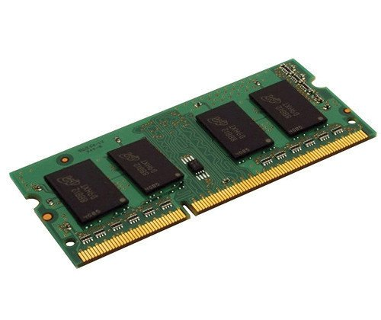

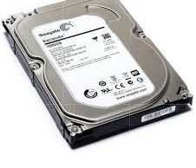
HARDWARE
REQUIREMENTS
Laptop
Hard Disk
RAM

Slide 7
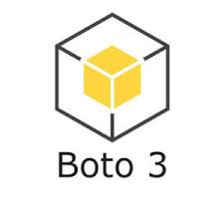



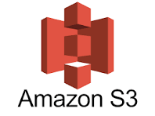
AWS SNS (Simple Notification Service)
AWS S3
Streamlit
Boto3 (AWS SDK for Python)
Operating System – Ubuntu 20.04 or latest versions
SOFTWARE
REQUIREMENTS

Slide 8
Existing object detection methods include Canny Edge Detection, which identifies object boundaries in images and is useful for basic tracking. Lucas-Kanade Optical Flow tracks the movement of objects across video frames, helping with motion detection and video tracking. Background Subtraction using OpenCV (KNN) detects moving objects by separating them from a static background, making it effective for real-time motion detection, especially in surveillance.
EXISTED SYSTEM

Slide 9
The proposed system aims to build a real-time object detection platform that uses YOLOv5 and YOLOv8 models for accurate object detection in live video streams and uploaded videos. It also detects dangerous items and sends real-time alerts via AWS SNS.
The key features include:
Dual Input Support: Works with both live webcam streams and uploaded videos.
Hazard Detection & Alerts: Sends alerts when dangerous objects are found.
Cloud Storage: Saves detection data securely in AWS S3.
PROPOSED SYSTEM

Slide 10
OBJECTIVES
OBJECTIVES
Accurate Real-Time Detection: Uses YOLOv5 and YOLOv8 models to deliver high-accuracy object detection from both live webcam streams and uploaded videos, ensuring reliable surveillance.
Instant Alerts: Detects dangerous objects (like knives, guns, bombs) and sends immediate alerts via AWS SNS, facilitating timely responses to potential threats.
Secure Data Storage: Stores all detection data in AWS S3, providing safe and persistent storage for future analysis and auditability.
Scalable and Cloud-Integrated: Designed to scale and integrate with cloud services, ensuring that the system is adaptable for various real-world deployment scenarios, including public safety and smart monitoring.

Slide 11
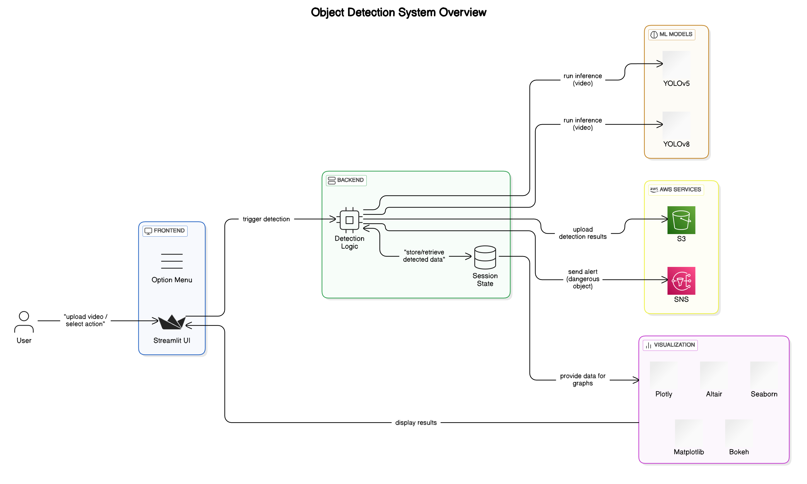
SYSTEM ARCHITECTURE

Slide 12
Algorithms used and its working
YOLO is a deep learning-based object detection algorithm that performs classification and localization in a single forward pass, making it extremely fast and efficient for real-time applications. YOLOv5 and YOLOv8 are the latest versions, known for their accuracy and speed improvements.
Working
Input Processing: The image or video frame is resized and passed to the YOLO model.
Grid Division: YOLO divides the image into a grid. Each grid cell predicts bounding boxes and class probabilities.
Object & Class Prediction: Each box predicts the object's location (x, y, width, height), a confidence score, and the object’s class (e.g., person, car, knife).
Output: The final frame shows all detected objects with labels and confidence levels in real time.
Algorithms used and its working

Slide 13
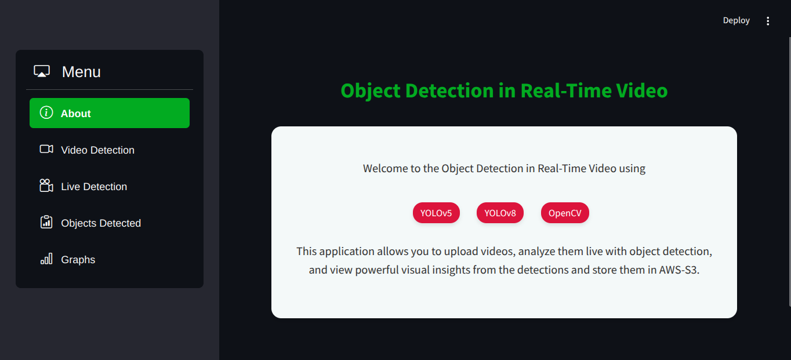
SAMPLE OUPUTS

Slide 14
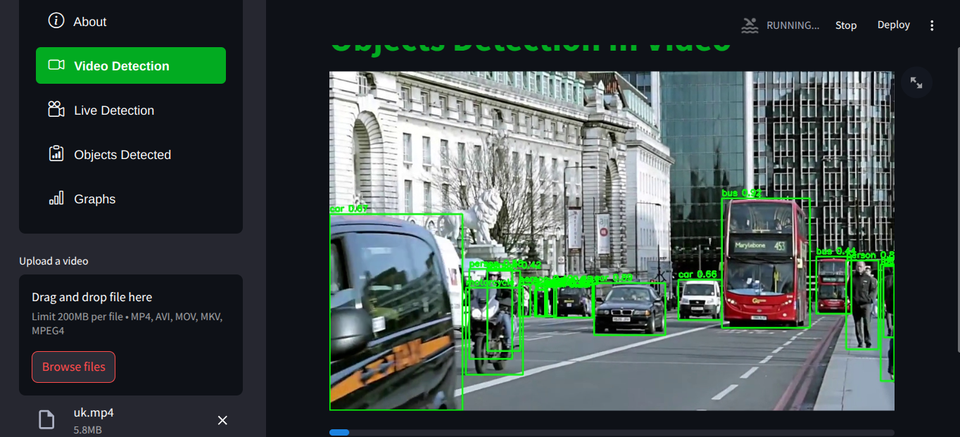
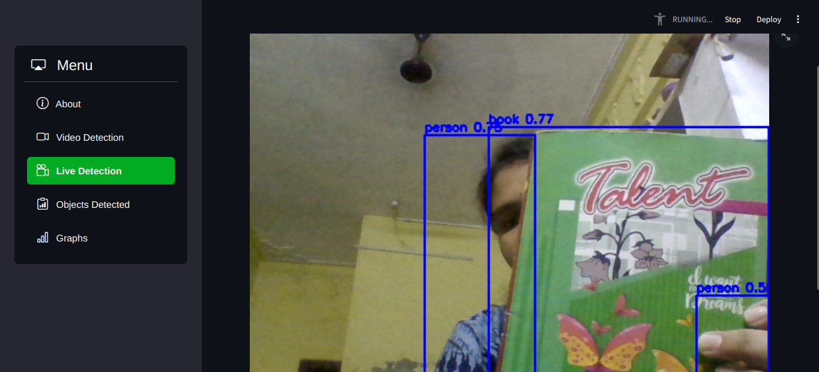

Slide 15
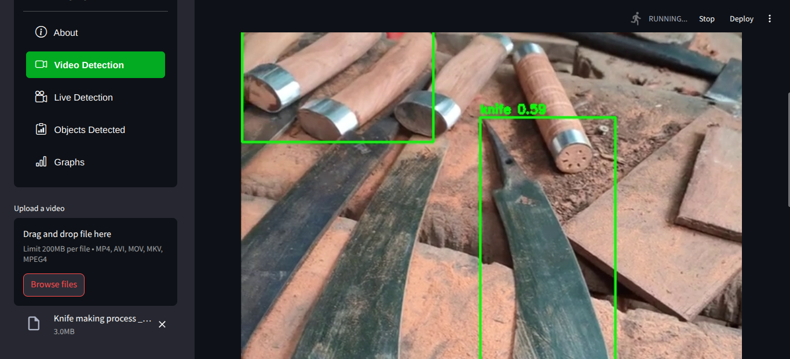
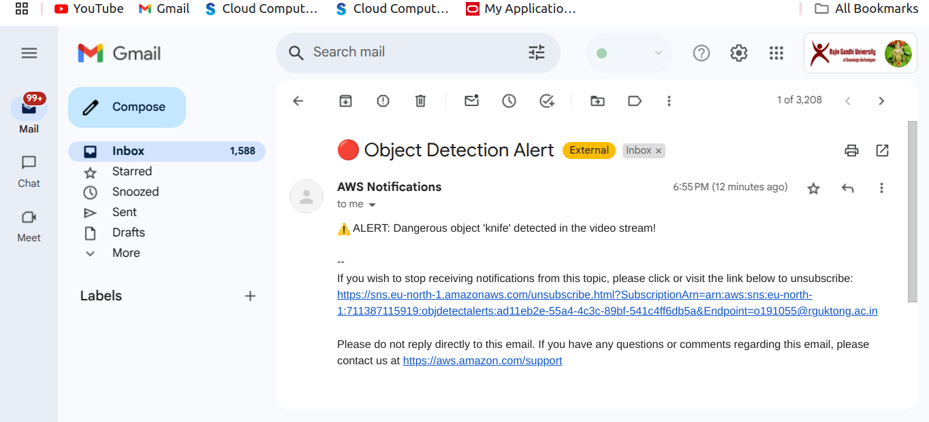

Slide 16
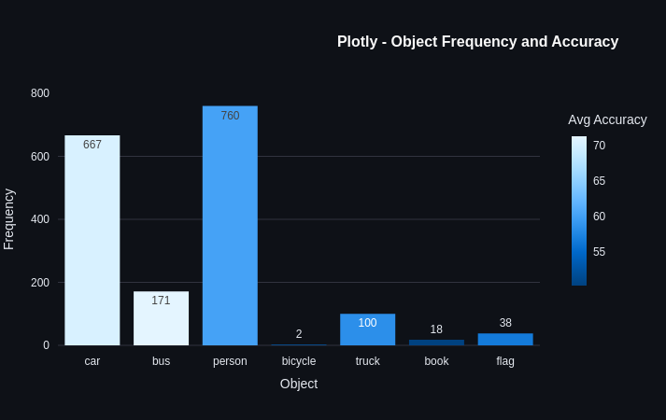
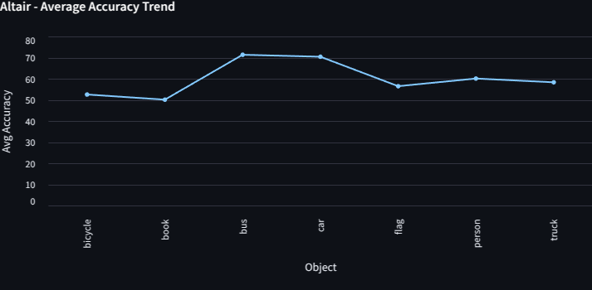
GRAPHS
GRAPHS

Slide 17
CONCLUSION
This project presents a Smart Surveillance System with Real Time Threat Detection Using AWS leveraging advanced deep learning model YOLOv5 and YOLOv8. It supports both live webcam feeds and pre-recorded video uploads, ensuring flexibility in monitoring various environments. The system is capable of identifying hazardous objects such as knives, guns, and bombs, and provides real-time alerts using AWS Simple Notification Service (SNS). Detected data is securely stored in AWS S3, while an interactive Streamlit interface offers users intuitive visualizations and insights.
“This solution is developed with the primary goal of improving safety and security in real-time. By detecting threats early and sending immediate alerts, it serves as an effective tool for modern surveillance systems in public, private, and industrial spaces”

Slide 18
1. Real-time Threat Detection Deployment : Deploy the application in public areas like airports, malls, or schools.
2. Cloud Integration for Scalable Monitoring: Use AWS services such as Lambda, Rekognition, or SageMaker to enable scalable processing.Store and analyze long-term logs with AWS CloudWatch or Athena for retrospective insights.
3. Security and Authentication:Secure dashboards and alert systems with user authentication using AWS Cognito or Firebase.
FUTURE SCOPE

Slide 19
REFERENCES
[1]. K-means Clustering for Color-Based Detection – Proposed by J. MacQueen (1970)
[2]. University of New Brunswick - CICIDS Projects – Led by John F. Canny (1986)
[3]. Simple Object Tracking using Lucas-Kanade Optical Flow – Proposed by Bruce D. Lucas and Takeo Kanade (1981)
[4].Background Subtraction using OpenCV (KNN or MOG2) – Proposed by P. KaewTraKulPong and R. Bowden (2001)
[5].PCA (Principal Component Analysis) for Object Detection – Authored by Kaiser and Rice (1965)

Slide 20


